Slide 1
The Woman’s Club of Raleigh
Gala 2025
Givesmart

Slide 2
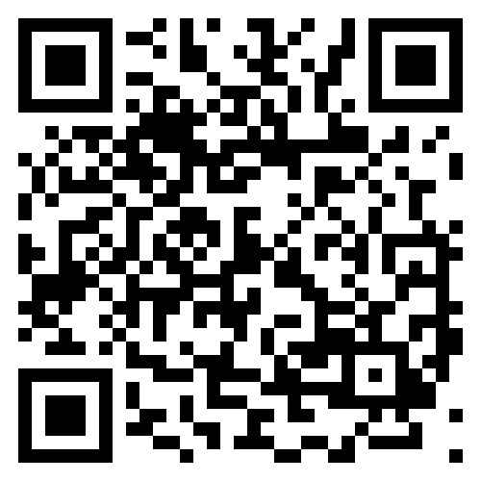
TWCRGala2025.givesmart.com
Take
Take your Phone Camera
Focus over
Focus over the QR Code
Touch
Touch the yellow indicator that says ’Open In Chrome’

Slide 3
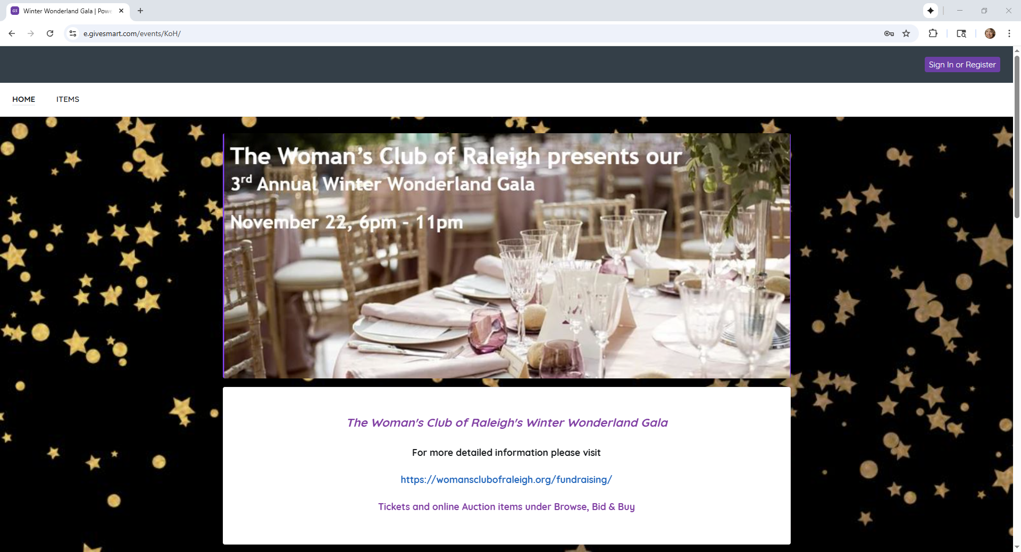

TWCR Gala website – how to register

Slide 4
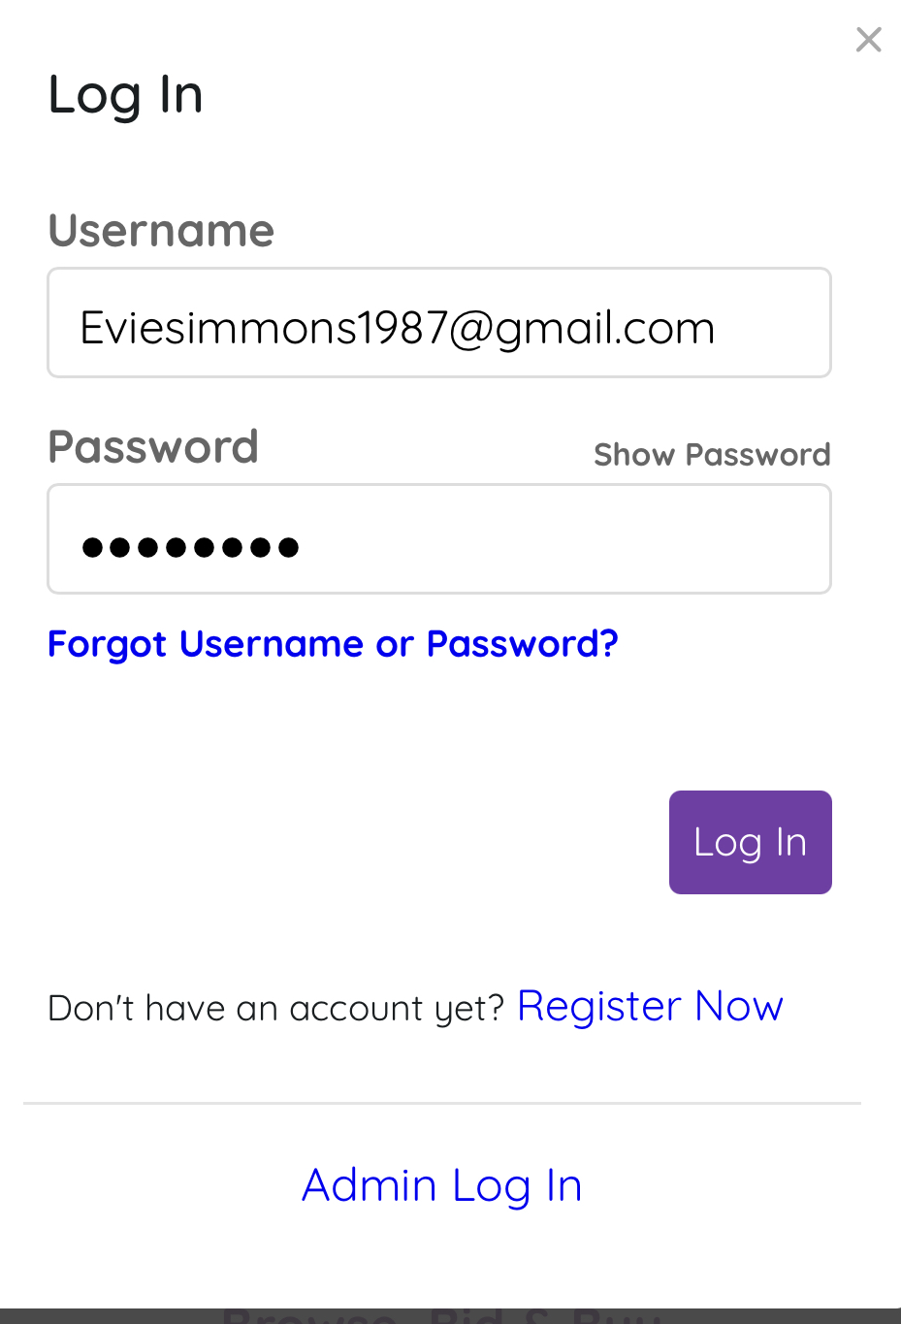

Sign In / Register Now

Slide 5
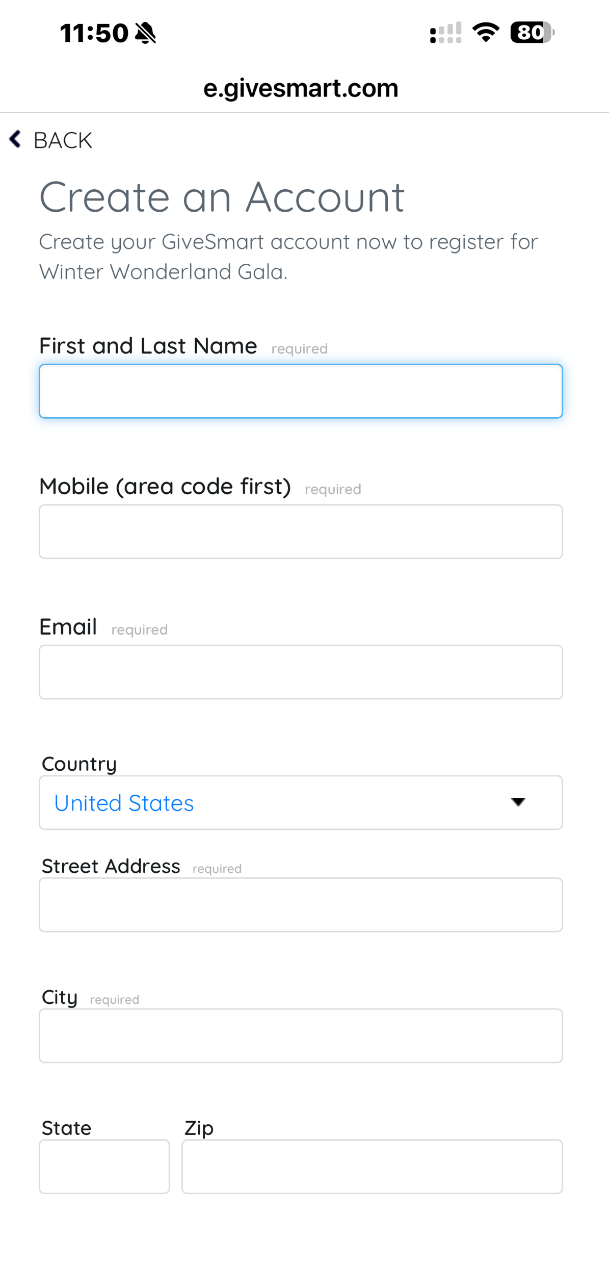
Create an Account

Slide 6
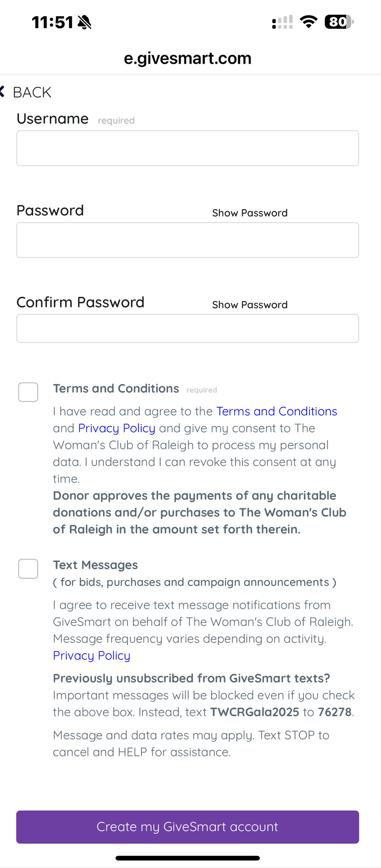
USERNAME
Email address
PASSWORD
Birthdate with Wc! at the end ex: 01011990Wc!

Slide 7


Welcome -- You are now registered!

Slide 8
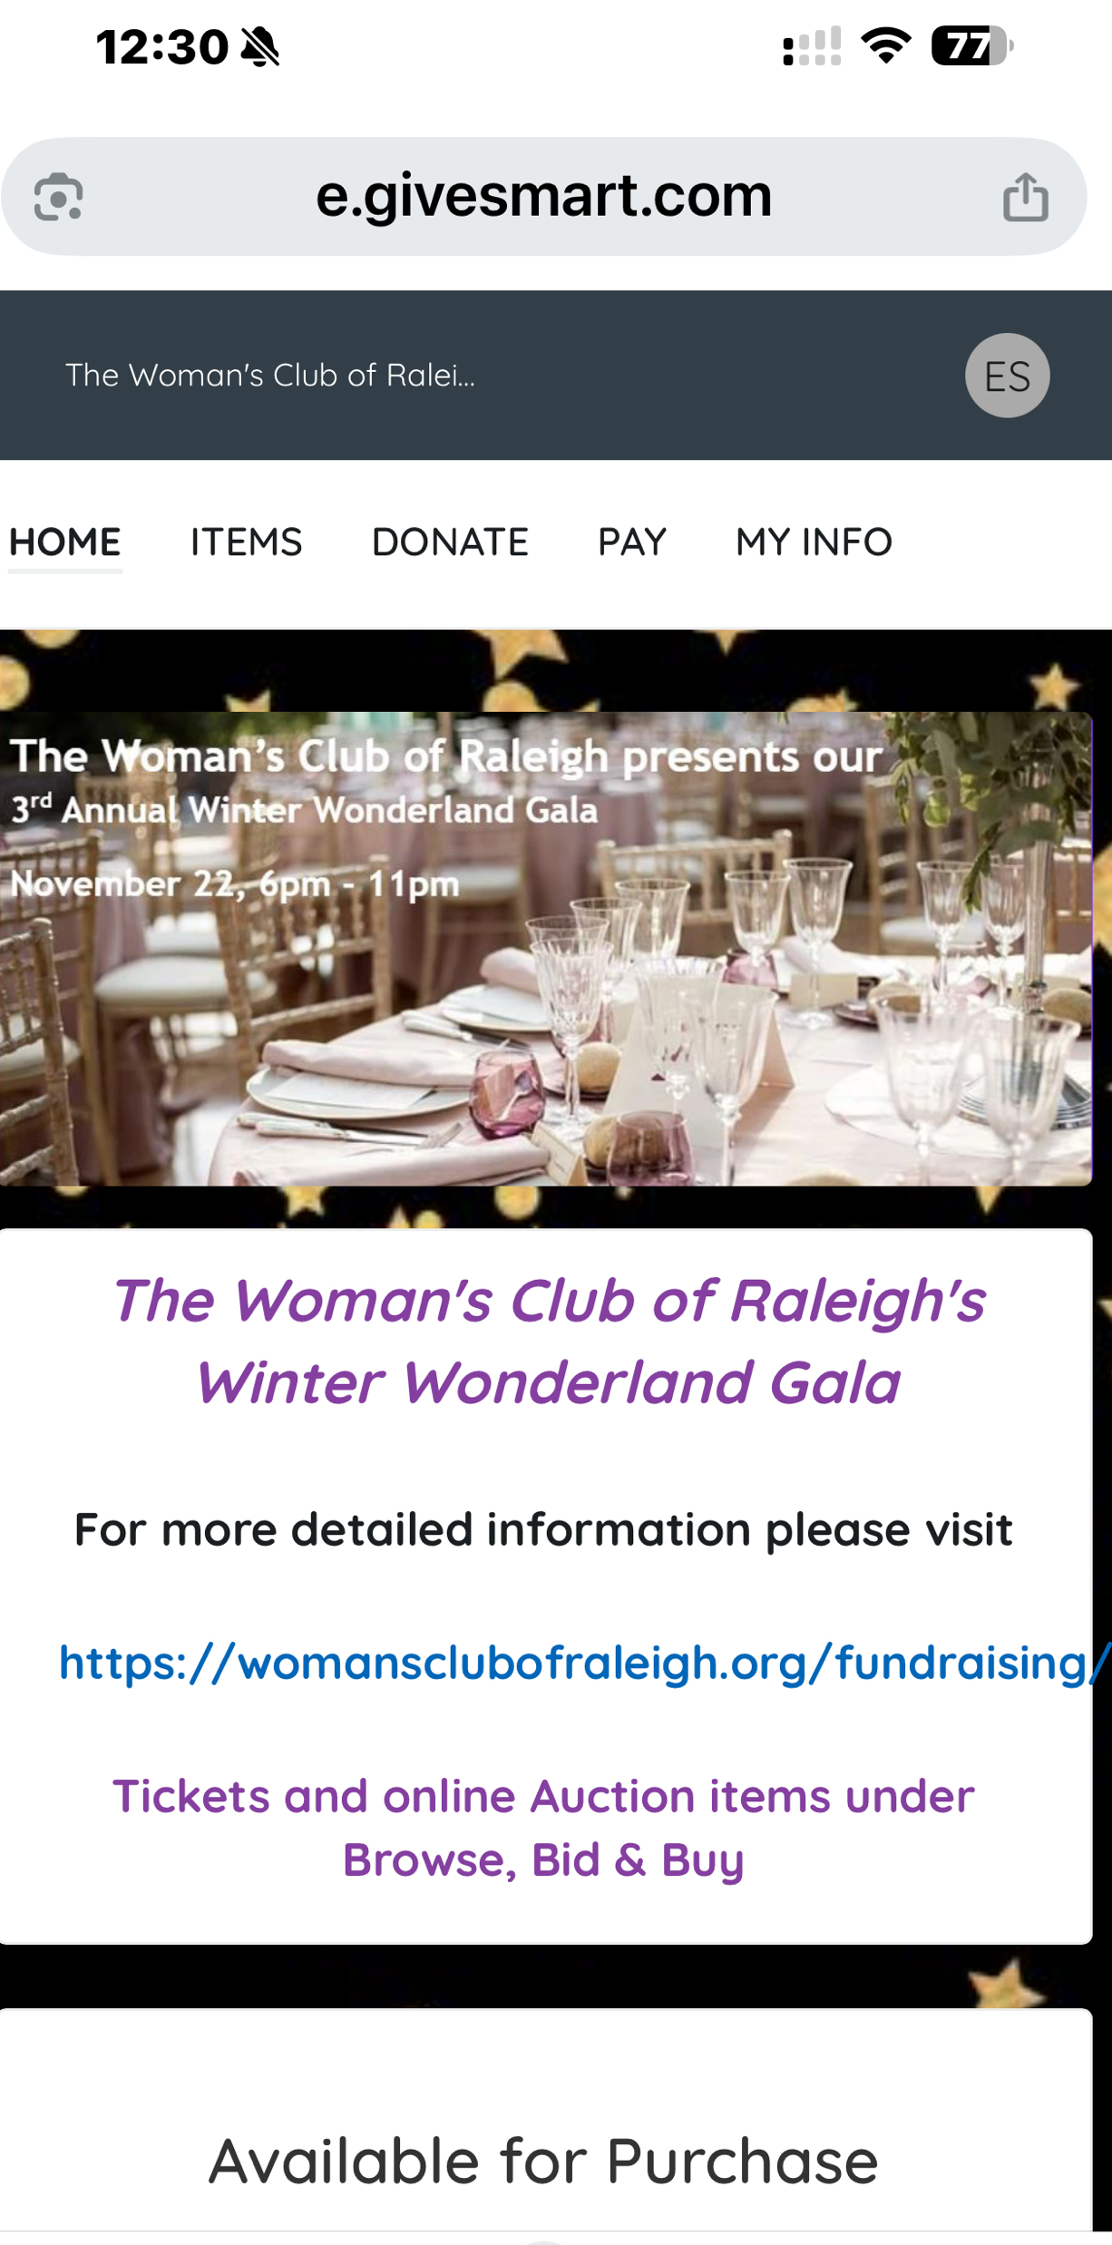

Scroll down to Available for Purchase

Slide 9
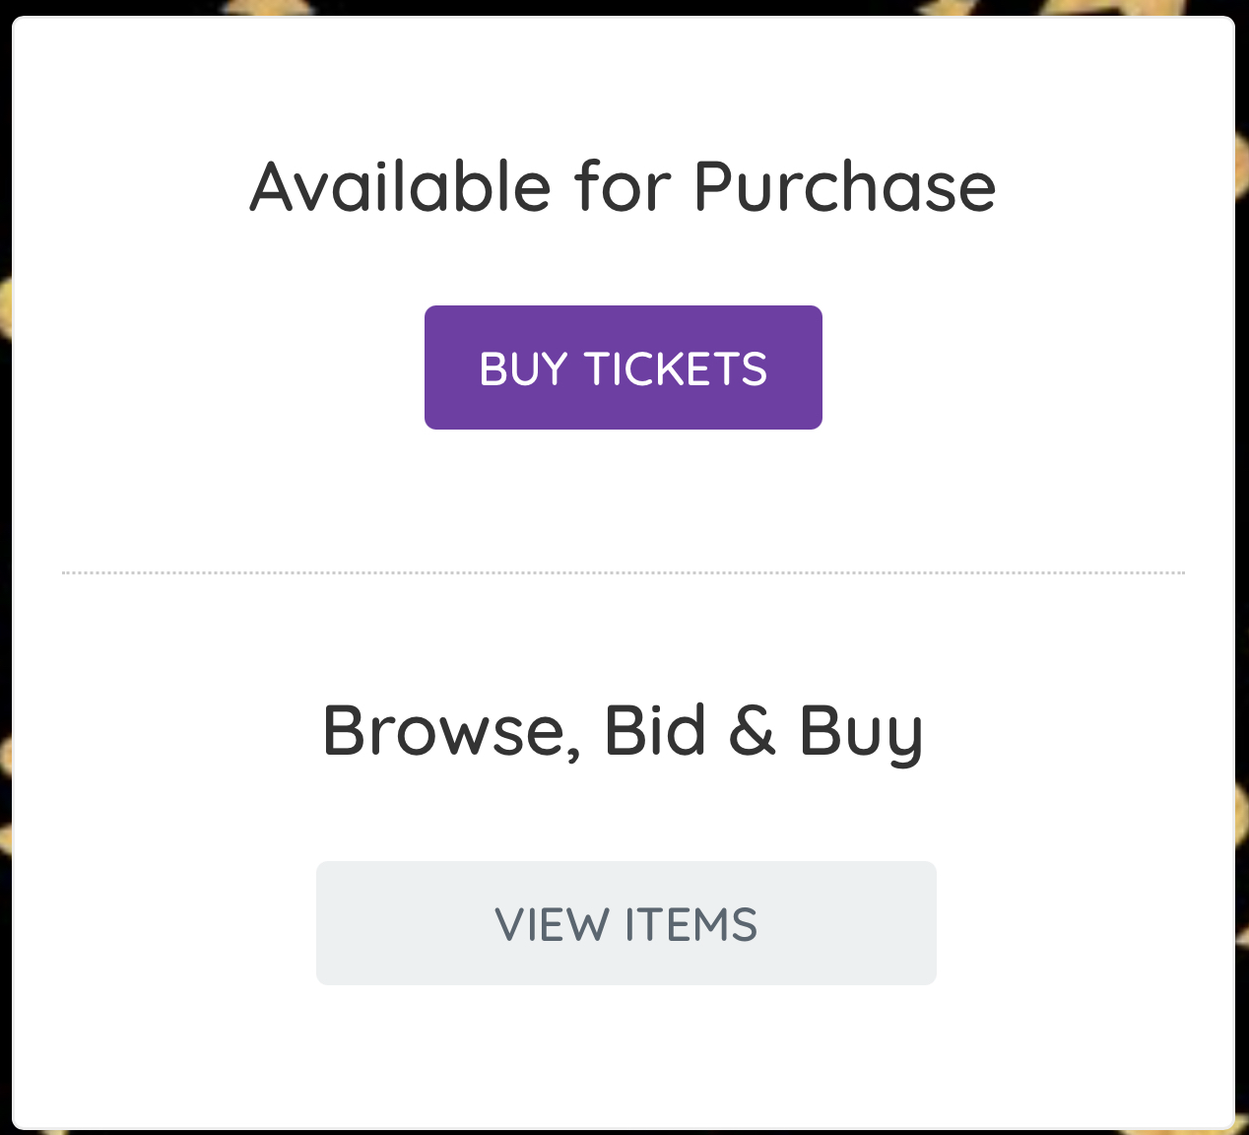
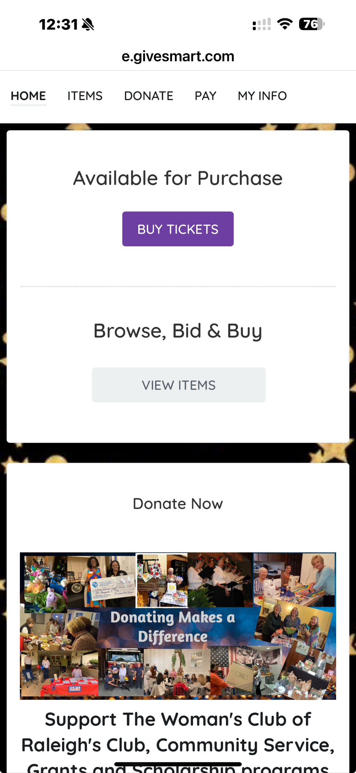
Purchase/Browse/Bid&Buy

Slide 10
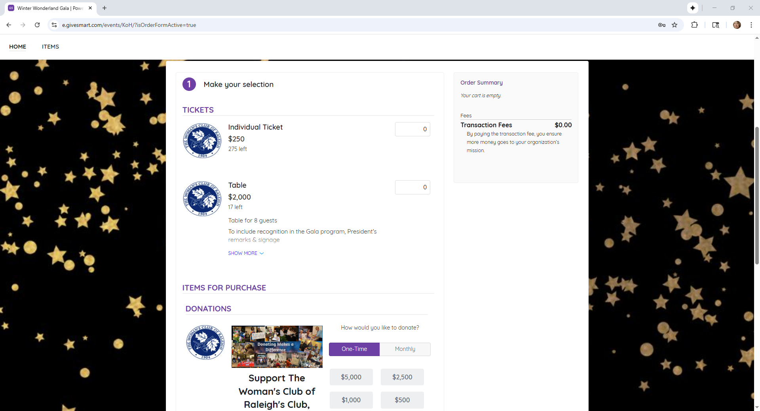
Buy Tickets

Slide 11

Donate Now!

Slide 12
Thank you!

